Slide 1
Growing Object-Oriented Software, Guided by Tests Part 1
Martin Stolle, 04.07.2018

Slide 2
Über das Buch
Autoren Steve Freeman und Nat Pryce
UK
Software Berater
Gründer London XP Days
2010 Veröffentlicht
Theorie ← Wir sind hier
Anwendung in der Praxis anhand eines Beispiels
Testbarkeit erhalten im Projektverlauf

Slide 3
Inhalt
Implementing TDD effectively: getting started, and maintaining your momentum throughout the project
Creating cleaner, more expressive, more sustainable code
Using tests to stay relentlessly focused on sustaining quality
Understanding how TDD, Mock Objects, and Object-Oriented Design come together in the context of a real software development project
Using Mock Objects to guide object-oriented designs
Succeeding where TDD is difficult: managing complex test data, and testing persistence and concurrency
Quelle: http://www.growing-object-oriented-software.com/index.html, 25.06.2018

Slide 4
Warum TDD?
Learn how components work whilst completing the project
System that combines many components will be too complex to understand
Anticipate unanticipated changes
Empirical feedback to learn and the system and its use
Team needs repeated cycle of activity
Deployment is critical at each cycle
Deployment is to check assumptions against reality
Project organized with loops is incremental and iterative
Incremental: build system feature by feature
iterative : refine implementation in response to feedback
“You have nothing to lose but your bugs”

Slide 5
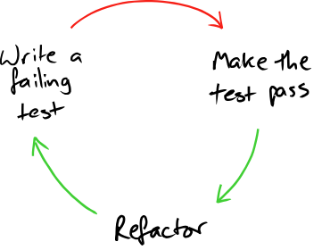
TDD in a nutshell
2 foundations for growing code
Constant testing
Keep code as simple as possible
Easier to understand and modify
Devs read more code that write
Refactor: micro technique, small scale improvements without changing the behaviour
Quelle: http://www.growing-object-oriented-software.com/figures/tdd-simple.svg, 25.06.2018

Slide 6
TDD in a nutshell
Start with acceptance test
When it passes feature is done
Outer cycle: Acceptance test
Inner cycle: Unit test
End-to-end: interact with the system only from the outside
Acceptance test: Does the system work?
Integration test: Does our code work against code we can’t change?
Unit test: Do our objects do the right thing, are they convenient to work with?

Slide 7
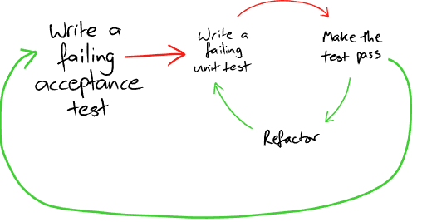
TDD in a nutshell
Quelle: http://www.growing-object-oriented-software.com/figures/tdd-simple.svg, 25.06.2018

Slide 8
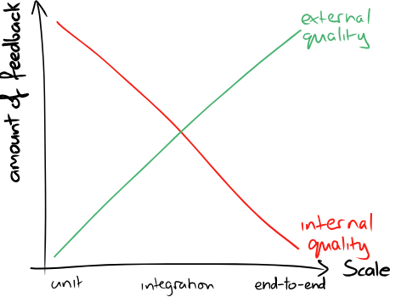
TDD in a nutshell
External quality: how well system meets the needs of its customers and users
Internal quality: how well it meets the needs of its developers and admins
It allows us to modify the system behavior safely and predictably
End-to-end tests = external quality
Unit tests = internal quality, feedback for design
Loosely coupled and highly cohesive
Coupled:
if a change in one force a change in the other
Cohesion:
Is a measure of weather its responsibilities form a meaningful unit
Quelle: http://www.growing-object-oriented-software.com/figures/quality-feedback.svg, 25.06.2018

Slide 9
TDD with objects
Object:
receives & send messages (more important than internal properties or behaviours)
identity might change depending on the message they receive
Method
handles message it understands
Encapsulates internal state to coordinate communication
System:
Composition of objects
Web of collaborating objects
Change behaviour by changing composition
Values: Model unchanging quantities and measurements

Slide 10
TDD with objects
Communication pattern is a set of rules that govern how a group of objects talk to each other
The roles they play, what messages they can send
Define roles with abstract classes
Object
Implementation of one or more roles
Role
Set of related responsibilities
Responsibility
Obligation to perform a task or know information

Slide 11
CRC-Cards
By Wirfs-Brock and McKean, Object Design: Roles, Responsibilities, and Collaborators, Addison-Wesley, 2003
Index cards to explore the potential object structure of an application
Game Engine
Displays State Updates game state Resolves Collisions
Renderer Animator Collision Detection

Slide 12
TDD Tools
The calling object should describe what it wants in terms of the role that its neighbour plays “Tell, Don’t ask”-Law of Demeter
Asking still allowed occasionally
Objects make decision based on the info they hold internally or that came with the message
Avoid navigation to other objects
Use mock to specify how we expect the target object to communicate with its mock neighbours
master.getModelisable().getDockablePanel().getCustomizer().setEnabled(true); master.allowSavingOfCustomisations();

Slide 13
TDD Tools
Mockery
Holds context of a test, creates mock objects and manages expectations and stubbing for the test
Create required mocks
Create any real objects
Specify how you expect the mock objects to be called
Call target
Assert resulting values are valid and all calls are made

Slide 14
TDD - Kickstart
Start with build, test deploy
Walking Skeleton
Flushing out technical and organizational risk
After that: acceptance test
Deploy
Understanding the process while automating it
Draw the walking skeleton on a whiteboard, understand the problem
Broad brush design
Front load stress!

Slide 15
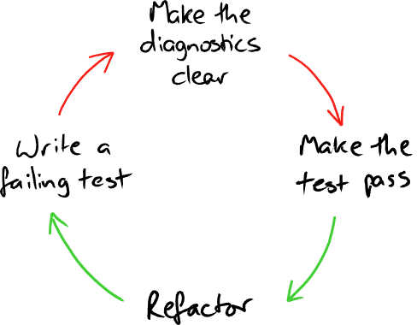
TDD Cycle revisited
Write failure test cases down, later implement them
Write test that you’d want to read
TestDox convention
Error messages should guide us, express indent of the test
Develop from the inputs to the outputs
Test should not just show what it does, but what the method is for
Quelle: http://www.growing-object-oriented-software.com/figures/quality-feedback.svg, 25.06.2018

Slide 16
TDD Cycle revisited
Write acceptance test using only terminology from the application domain
Not from underlying technology
Focus on implementing the feature
Look at the system from users point of view not implementers
Unit test exercise objects in isolation
Helps with design and confidence
Unit and integration test support the dev team
Quick and always pass
Acceptance tests for completed features should always pass
Don’t start with failure cases, start with the simplest success not that simplest case
Starting with failure bad for morale not with the simplest

Slide 17
OOP Style
Difficult to test? Don’t ask how to test but why it is difficult
Fear kills progress
How well is our TDD strategy
Reflect regularly, identify weaknesses
Value code that is easy to maintain than easier to write
Separation of concerns
Change as little code as possible to change behavior of a system
Higher levels of abstraction
Avoid complexity, program by combining components rather than manipulating variables and control flow
Encapsulation: behavior of object can only be affected through its API
Information hiding: coneals how an objects implements its functional behind abstraction of its API

Slide 18
OOP Style
Composite simpler than the sum of its parts
New objects encapsulates behaviour for easier use
3 types of relationships
Dependencies: Object cannot function without these services (Canvas)
Notifications: Object notifies interested peers whenever it changes state, fire and forget (Button)
Adjustments: Adjust objects behaviour to the wider needs of the system (Renderer)
Write helper methods to improve readability even if they are very small
Name these methods to make the calling code more readable
Functional programming style within an object, message passing style between objects
Single responsibility principle
Describe what objects does without “and/or”

Slide 19
OOP Style
The API of a composite object should not be more complicated than that of any of its components
Rule helps us decide whether and object hides enough information
Context independent: object has no knowledge where it executes
Relationship might be permanent passed in construction or transient, passed in method
Paternalistic approach: each object is just told enough to do its job
Context independence simplifies objects
Don't need to manage their own relationships
Managing relationship easier
Created and composed together in same place

Slide 20
Archiving Design
Starting with a test means we have to describe what we want before we consider how
Keep unit tests understandable by limiting their scope
Encourages context independence because we have to set up dependencies
System is a web of communication objects
Interfaces to define available messages
Dependency Inversion Principle / Liskov Substitution Principle
An interface describes whether two components will fit together, while a protocol describes whether they will work together

Slide 21
Achieving design
More important than the available messages (interfaces) are the patterns of communication - their communication protocols
If we receive message A, do we execute B?
Mock objects make communication protocols visible
See the objects peers
Mocks encourages information hiding
The less you mock the better
Mock dependencies, notifications, adjustments but NOT internals
Types to represent value concepts in the domain
Create a consistent domain model

Slide 22
Achieving design
Value
immutable, simple, no meaningful identity
Objects:
have state, identity and relationships
Feet and meters and numbers but different things
Helps us find relevant code
3 basic techniques for introducing value types
Breaking out
code to complex > break out coherent units of behaviour into helper types
Budding off
Placeholder type for new domain concept, as code grows fill in more details
Bundling up
commonly group of values always used together, new type that highlights the missing concept

Slide 23
Achieving design
If code gets too complex to understand → clean up
Breaking out - Splitting large objects into a group of collaborating objects
Pulling out cohesive units of functionality into smaller collaborating objects
New objects can be tested
Forces us to look at the dependencies
Unit test say
Break up an object if it becomes too large to test easily, or if its test failures become difficult to interpret. Then unit-test the new parts separately
Treat code as spike
once we know what to do roll back and re-implement cleanly

Slide 24
Achieving design
Budding off – defining a new service that an objects needs and adding a new object to provide it
When implementing an object we discover that it needs a service
Give service a name, mock it in the unit tests to clarify relationship between the two
Then write an object to provide that service, repeat
Unit test say
When writing a test, we ask ourselves: „if this worked, who would know?“ If the right answer to that question is not in the target objects, its probably time to introduce a new collaborator

Slide 25
Achieving design
Bundling up: Hiding related objects into a containing objects
Composite is simpler that the sum of its parts
Name helps us understand the domain better
Scope dependencies more clearly
We can test the new composite object directly
Unit test say
When a test for an object becomes too complicated to set up – when there are too many moving parts to get the code into the relevant state – consider bundling up some of the collaborating objects
“Bloated constructor”

Slide 26
Achieving design
Interfaces reflect relationships between objects as defined by their communication protocols
Interfaces to name the roles that objects can play and to describe the messages they'll accept
To express intent in testing code use 2 layers
Implementation layer: graph of objects, behavior is combined result of how its objects respond to events
Declarative layer: builds up objects of implementation layer using small “sugar” methods to describe the purpose of each
Achieve more with less code
Raise ourselves from programming in therm of control flow and data manipulation to composing programs from smaller program where objects from the smallest unit of behavior

Slide 27
Walking Skeleton
Learn how to slice up the functionality so it can be built with little time
Each slice should be concrete that the team can tell when it is done
Iteration zero: setting up the infrastructure
Programming by wishful thinking
Write tests as if the application already exists
Avoid mocking external libraries
It may work different in another version
Write a thin layer of adapter objects that uses third party API
We test the adapter

Slide 28
Walking Skeleton
Name methods that trigger events in imperative mood
openConnection()
Names of assertions in indicative mood
isConnectionOpen()
Names should be descriptive
Failure defines target for our next coding episode
Outside-in development

Slide 29
Ende

